Slide 1
Predicting performance drops without ground truth labels
Results summary
31st October 2023

Slide 2
Methods

Slide 3
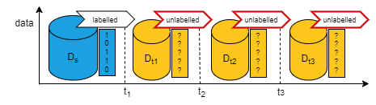
Unlabelled batch learning scenario

Slide 4
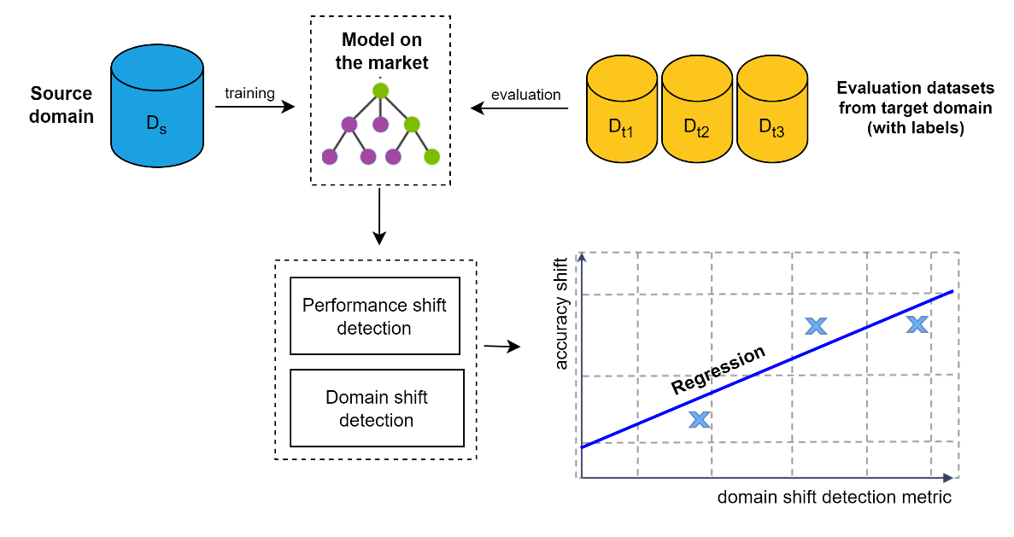
Regression of performance shift (on labelled sets)

Slide 5
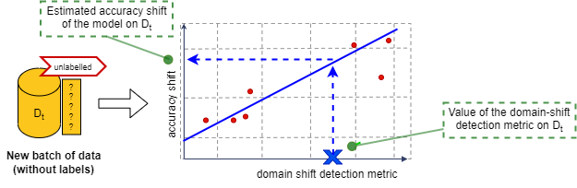
Prediction of performance shift (on new unlabeled set)

Slide 6
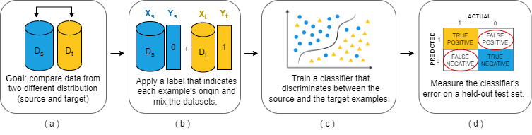
Metrics to predict performance shift
1) Discrimination error

Slide 7
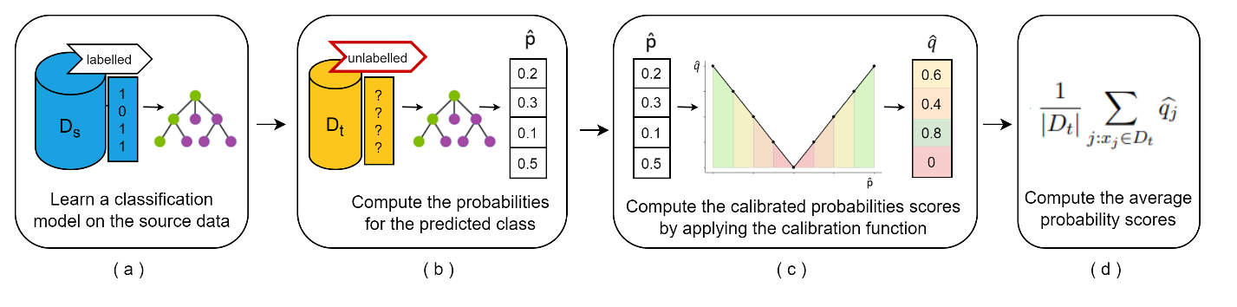
Metrics to predict performance shift
2) Average certainty score (AVRS)

Slide 8
Results Simulated data (AGRAWAL)

Slide 9
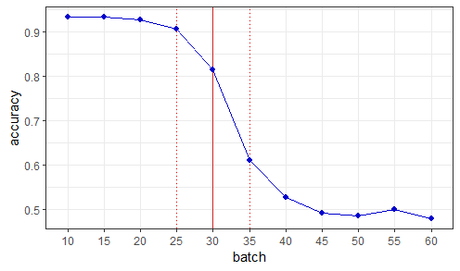
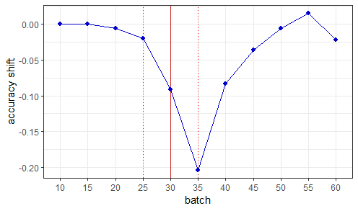
Simulated data (gradual drift at 30th instance)
*The shift is computed between subsequent batches

Slide 10
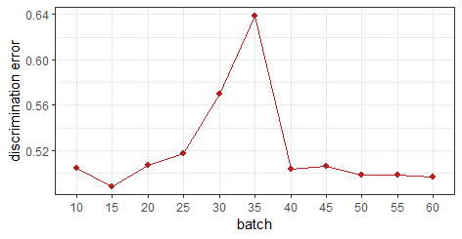
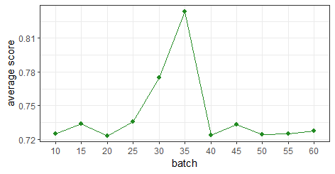
Metrics computation
*Something is actually changing around the instance where the drift is happening (spotted by both metrics)

Slide 11
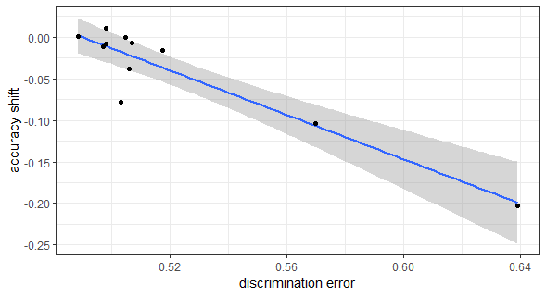
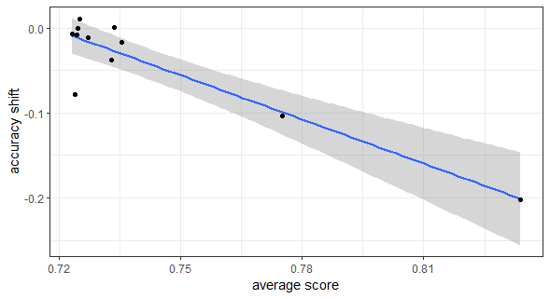
Regression models
*Negative correlation for both metrics.

Slide 12
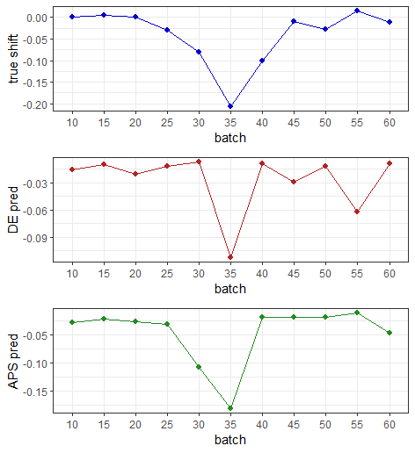
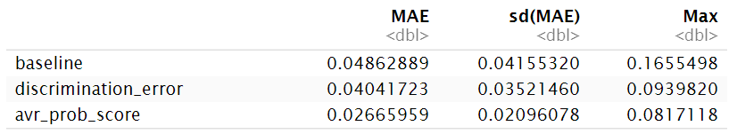
Shift prediction
*AVR score is the metric performing better in predicting the shifts.

Slide 13
Results Covid-19 data (accuracy, LR model)

Slide 14
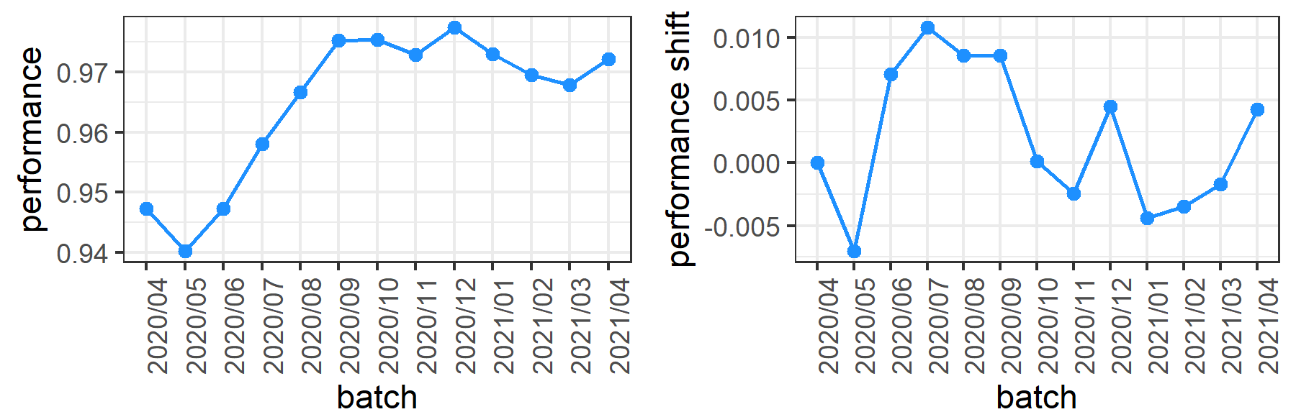
COVID-19 data (accuracy, LR model)

Slide 15

Metrics computation

Slide 16
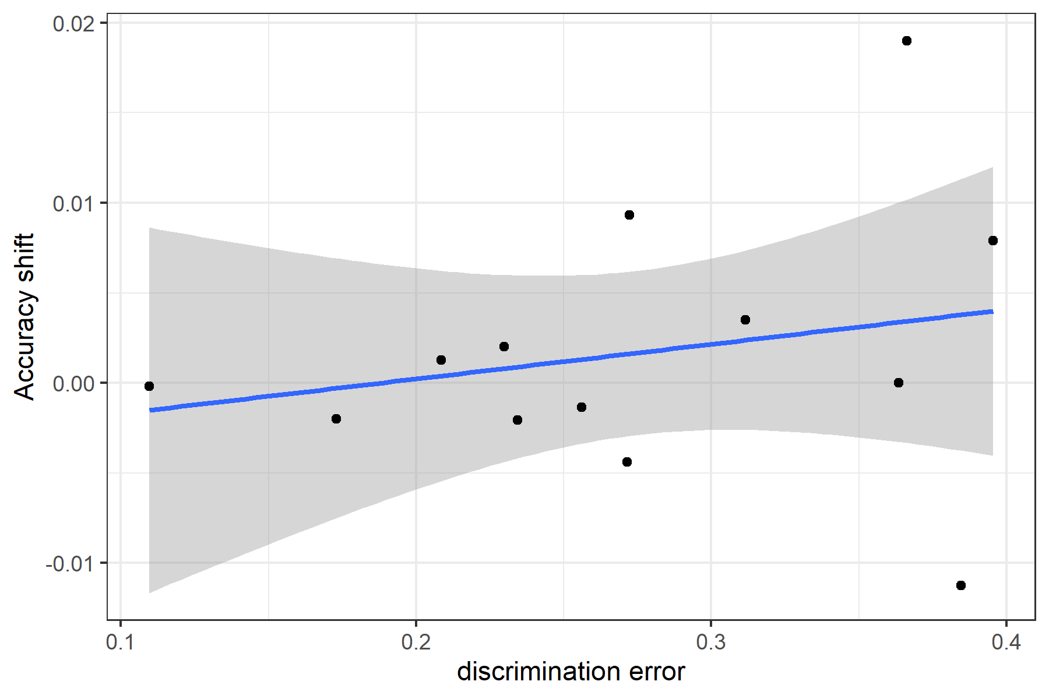
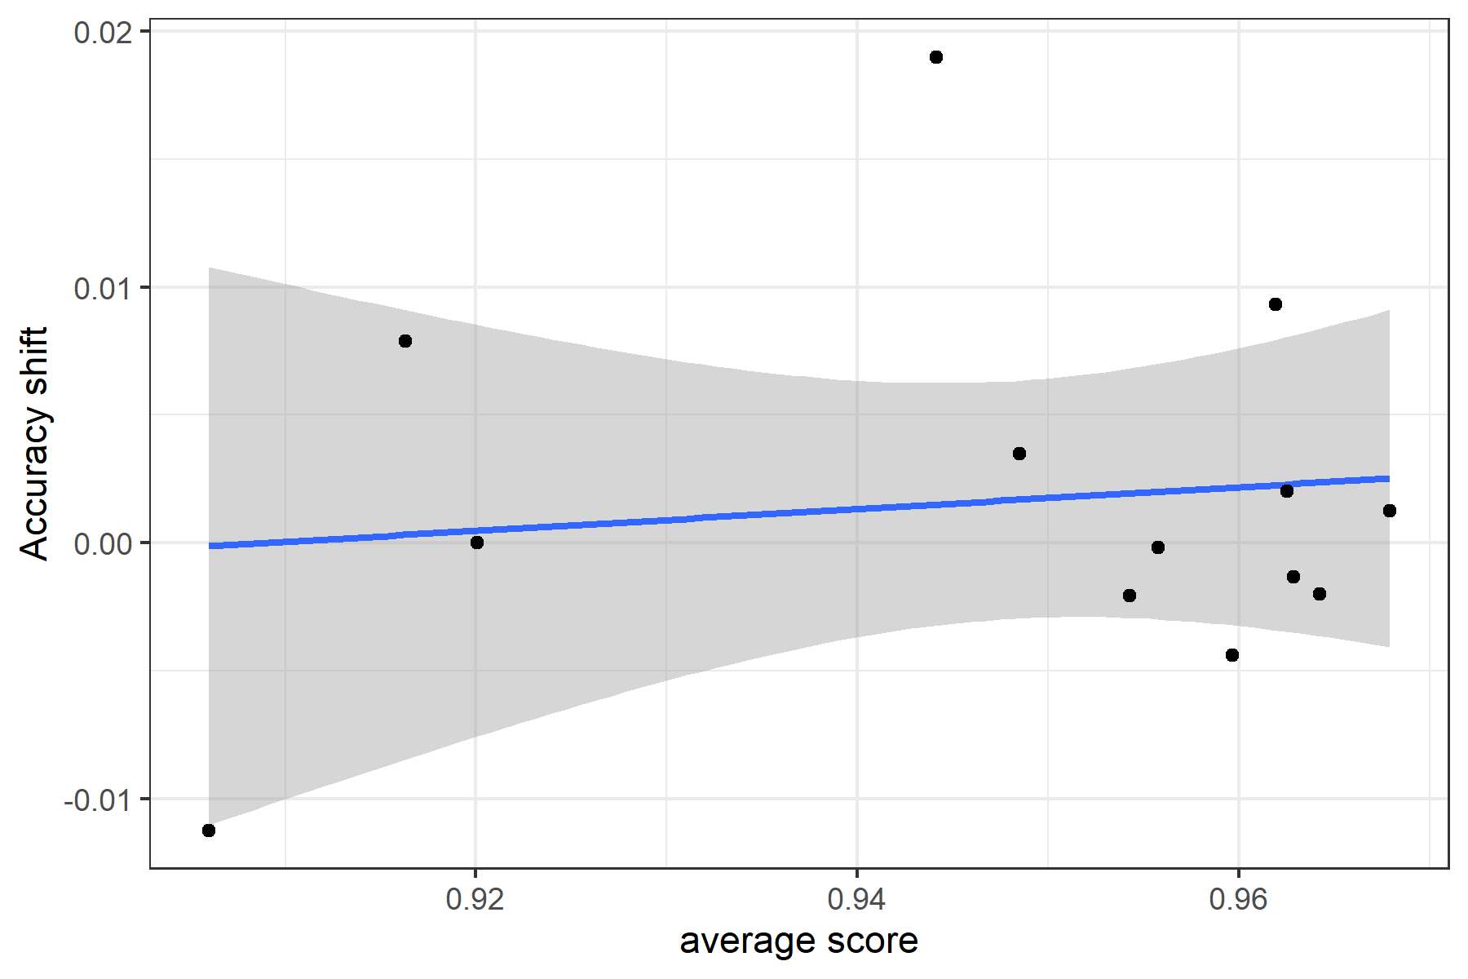
Regression models
*Positive correlation for both metrics.

Slide 17
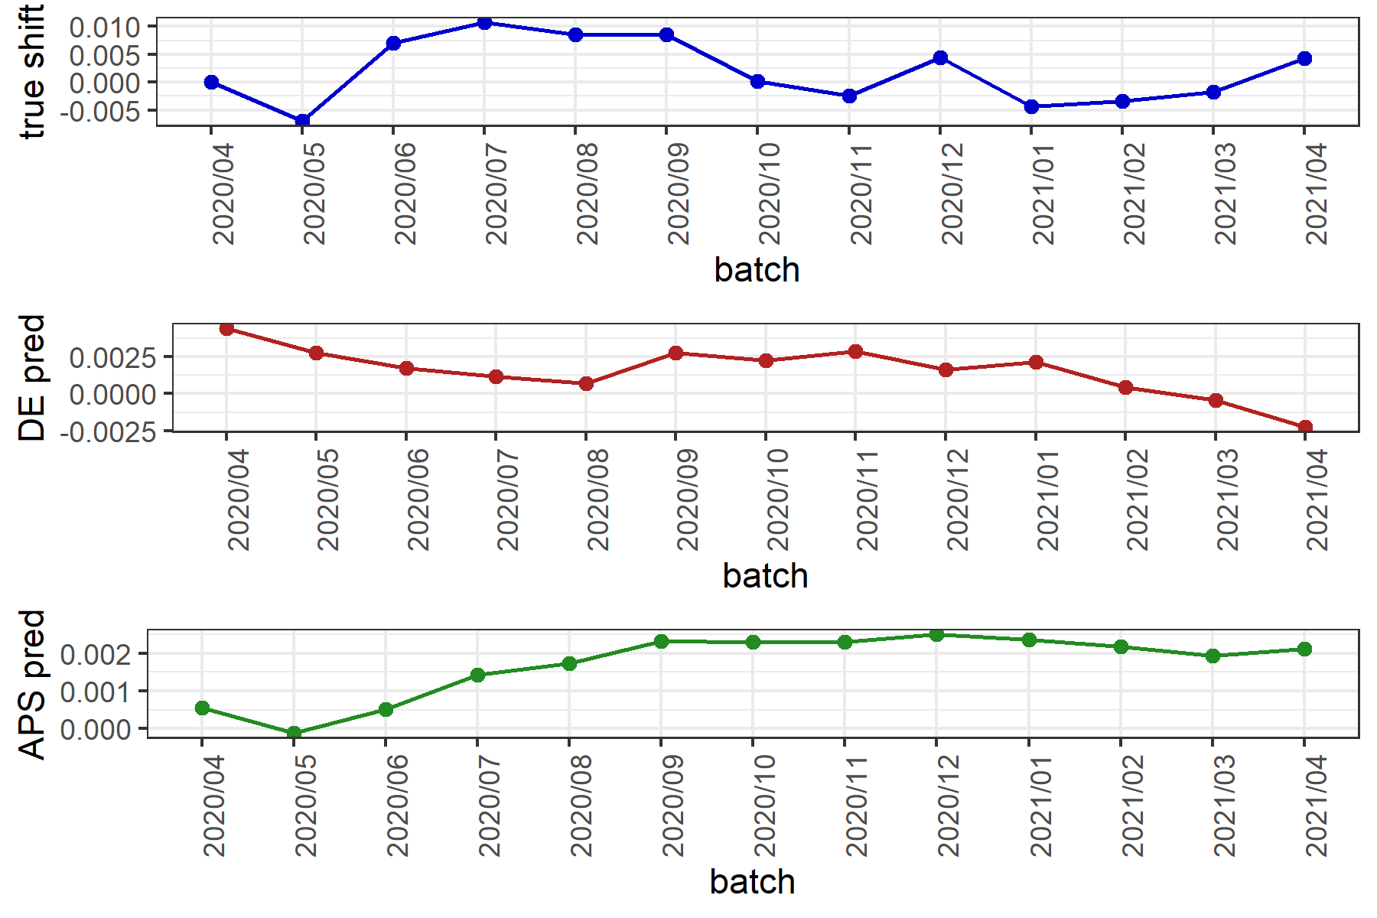

Shift prediction
*AVR score is the metric performing slightly better in predicting the shifts.

Slide 18
Results Covid-19 data (recall, LR model)

Slide 19
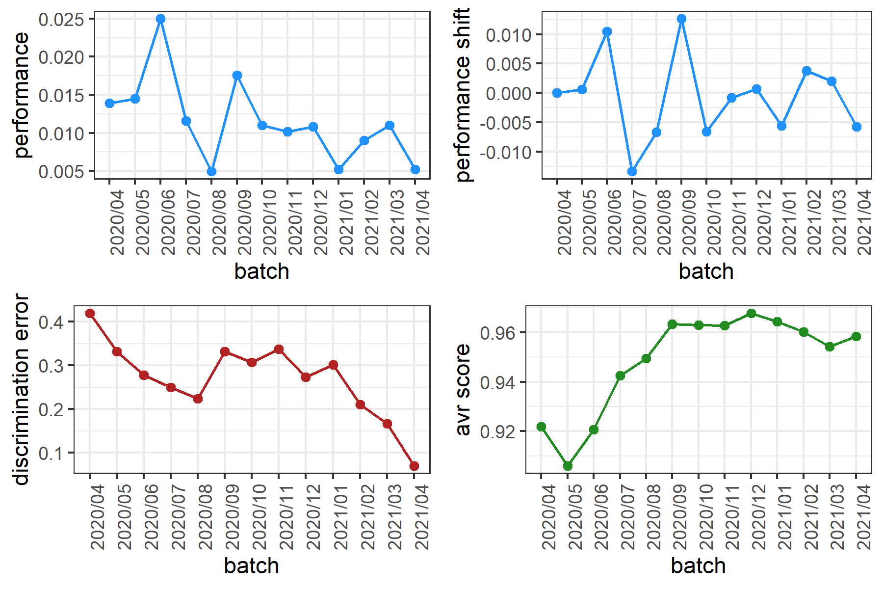
COVID-19 data (recall, LR model)

Slide 20
Metrics computation
*same results as before. The metric computation is not correlated to the performance metric you choose to predict. Is this an issue?

Slide 21
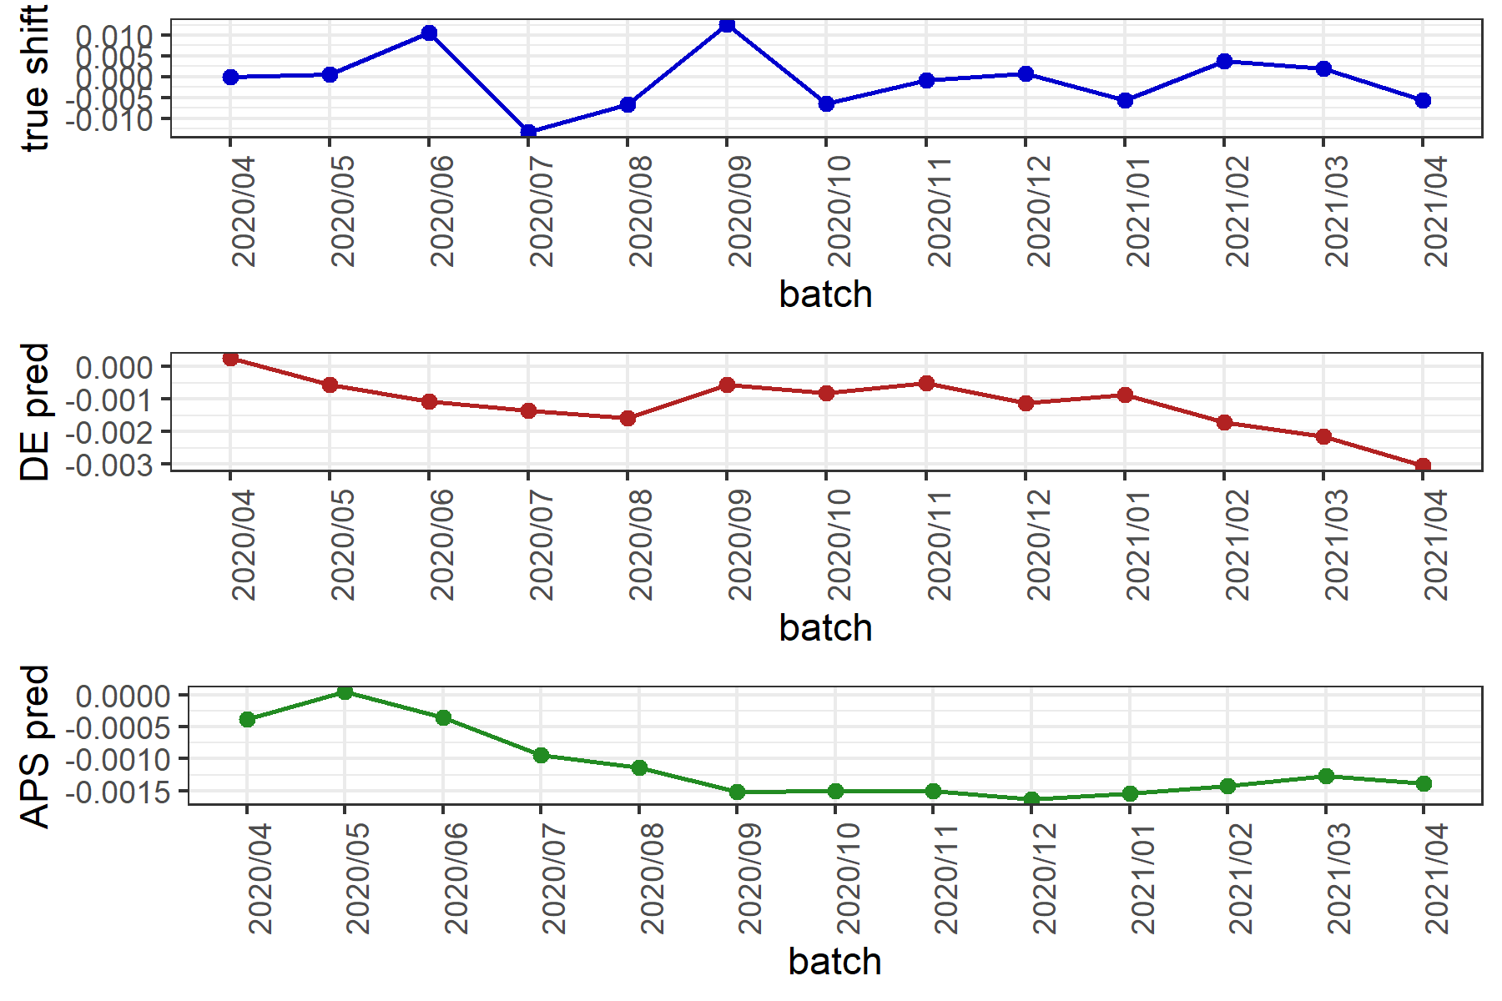

Shift prediction
Slightly better predictions using the DE metric.

Slide 22
Thought #1
When the discrimination error (DE) increases, it means that the models is struggling to separate between the source data (Ds) and the target data (Dt). It should indicate that the domains are similar (NO DRIFT ?).
Similar for the Average certainty score (AVRS). When it increases, it means that the model is more confident about its predictions. (NO DRIFT?)
For this reason, for the SIMULATED DATA, we were expecting the peak in the opposite direction.
Why it isn’t instead? Is it something to do with the generation method?

Slide 23
AGRAWAL generator
This generator consists of six numeric attributes and three categorical attributes to describe the hypothetical loan applications. For the numeric attributes, there is a perturbation factor that makes to shift the true value by adding an offset. It can produce ten different functions to determine whether the loan should be approved or not. The concept drift happens by changing the functions.
Reference: https://moa.cms.waikato.ac.nz/tutorial-5-simulating-concept-drift-in-moa/
Feature | Description | Type
salary | salary | continuous
commission | commission | continuous
age | age | continuous
elevel | education level | categorical
car | car maker | categorical
zipcode | zip code of the town | categorical
hvalue | house value | continuous
hyears | years house owned | continuous
loan | total loan amount | continuous
Dataset | Total instances | No. of classes | No. of drifts | Drift type | Drift width
Agrawal-60K | 60,000 | 2 | 1 | Gradual | 10,000

Slide 24
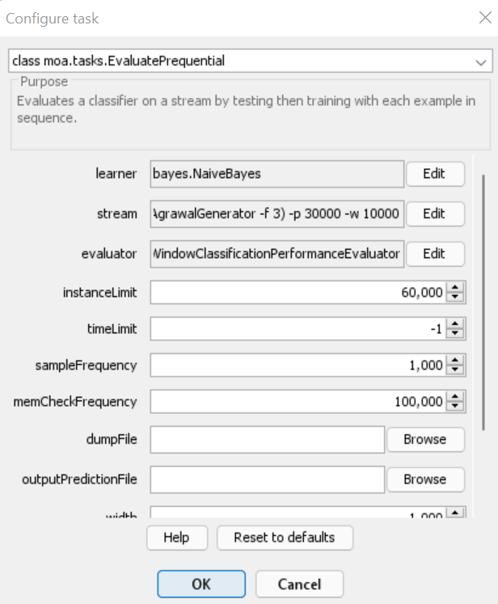
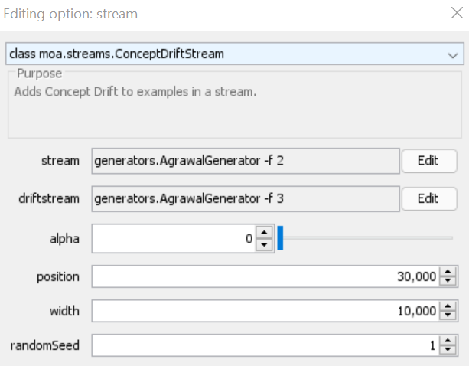
Simulating Concept drift with MOA
To simulate the drift, we use two different perturbation functions (f2, f3) to generate the instances.

Slide 25
Thought #1
However, the prediction of the shift seems to be pretty accurate (better for the AVR score, as the error is lower)

Slide 26
Thought #2
With COVID data, accuracy is going up even though the model is not re-trained. Can this be because the data is unbalanced? Qualitatively, we can spot 4 different shifts (where the performance jump is high from one batch to the following one)

Slide 27
Thought #2
The DE is decreasing over the time, indicating that shifts are more likely (low DE, means different domains i.e. SHIFT). The opposite trend is instead for the other metric. Why?

